Slide 1
CIS8695 Managing Big Data Analytics
Nasim Mousavi
Assistant Professor
J. Mack Robinson College of Business
Georgia State University
nmousavi@gsu.edu

Slide 2
Course Logistics

Slide 3





About Me
Assistant Professor of Information Systems
Education
PhD in Information Systems
MSc in Industrial Engineering
BSc in Industrial Engineering
Industry Experience
Data Scientist
Logistics Industry
Business Analyst
Construction Industry

Slide 4
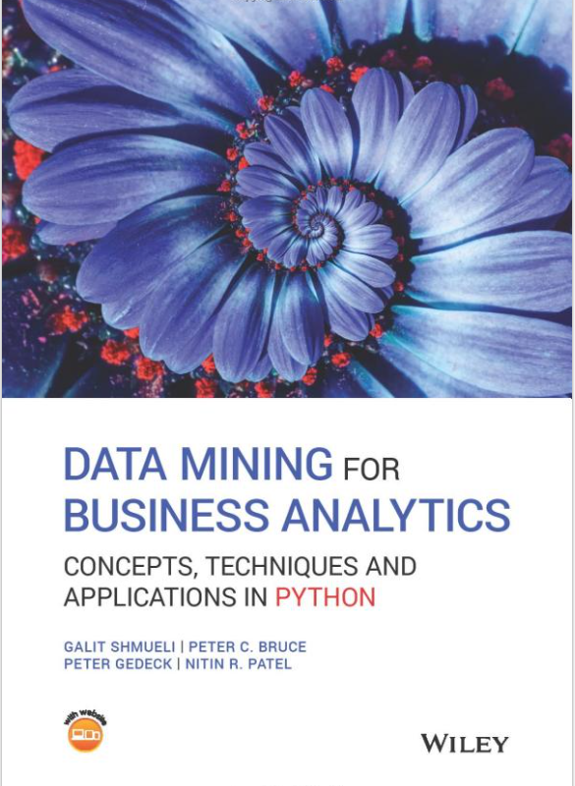
Main Textbook
Data Mining for Business Analytics: Concepts, Techniques and Applications in Python

Slide 5
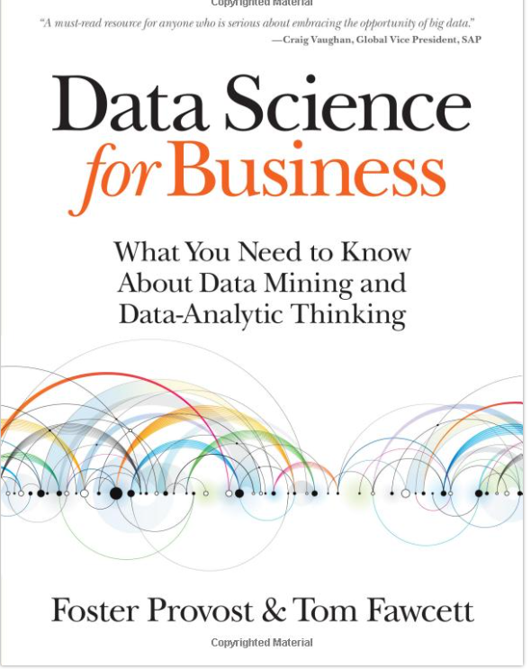
Additional Textbooks
Data Science for Business: What you need to know about data mining and data analytic thinking

Slide 6
Software
Python (Jupyter Notebook)
Anaconda (https://www.anaconda.com/download)
Google Colab (https://colab.research.google.com/)
Online Jupyter Notebook (https://jupyter.org/try-jupyter/retro/notebooks)

Slide 7
Schedule Overview
Class sessions will comprise
Lectures of relevant techniques, concepts, and features
Instructor demonstrations
Student lab sessions with in-class hands-on exercises (10%)
Homework Assignment (3 HWs) (25%)
Group Project & Presentation (30%)
Final Exam (35%)

Slide 8
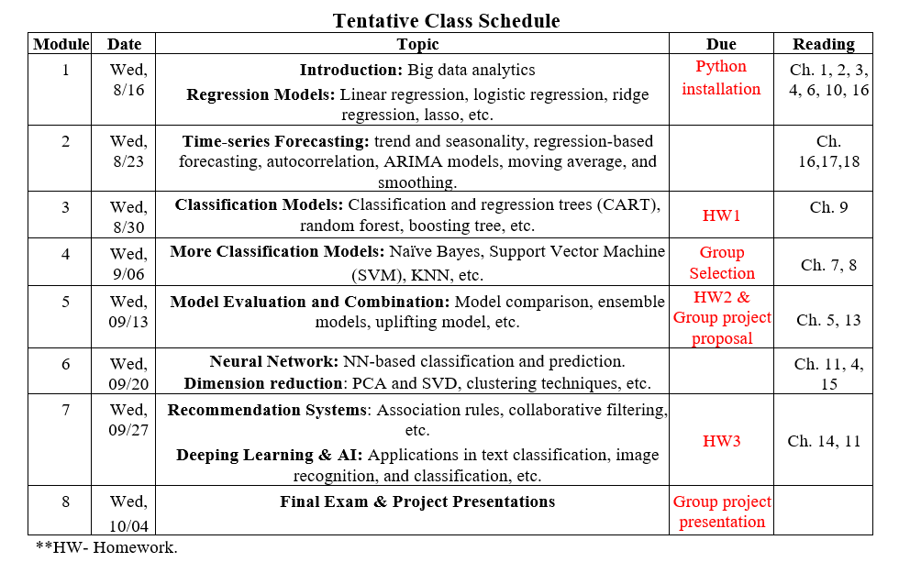
Detailed Schedule

Slide 9
Introduce Yourself
Name
Academic background?
If you are working, which industry?
Interest in big data analytics
Share with us one thing about yourself (that help us remember you)

Slide 10
Student Information: Online Survey
https://forms.gle/TH9gVoobBA7p4Pz76

